Slide 1
Project Sanity
Sanitization Reimagined

Slide 2
Problem Statement & Impact
Keeping indoor surfaces regularly sanitized is an arduous and repetitive task
Problem of determining high touch surfaces in new environments
Cleaning said surfaces frequently
Scalability; keeping track of the states (clean? Not clean?) of each surface
Hiring more human workers both reduces indoor capacity restrictions (leaving less for customers), and is not cost effective
What if we can automate this process with robots?

Slide 3
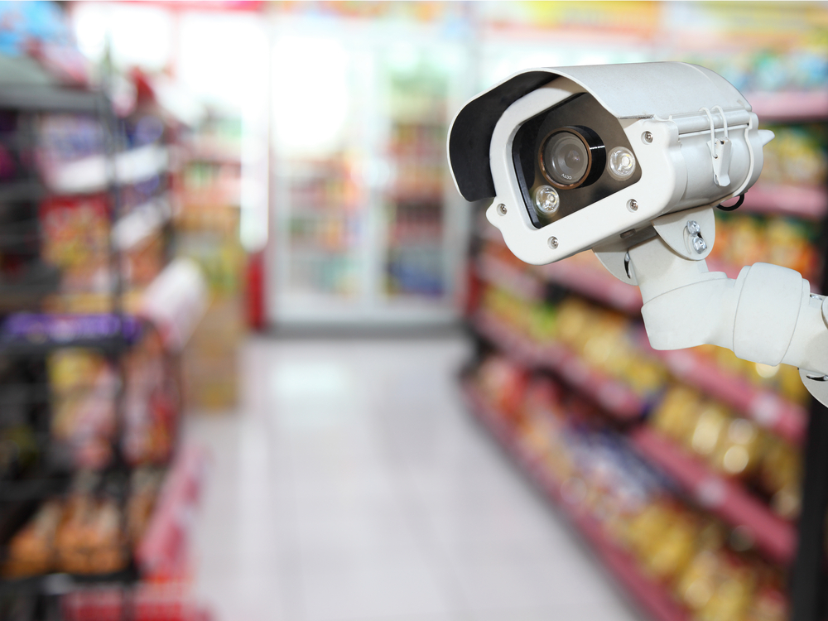
Object Recognition
Detect and locate high touch surfaces
MobileNet
To maximize the speed of object detection on live camera
Tensorflow
Designed using the Object Detection API
Transfer Learning
To allow rapid prototyping and iteration to optimize performance
Notes:
The primary objective of the system is to be able to recognize and target sanitation at high touch surfaces like tables, chairs, light switches, door handles, etc.

Slide 4
Mapping and Tracking
Where are the objects? Are they cleaned yet?
Transformations
A linear transformation can be used to transform camera feed to measurements in real life
OpenCV Visualization
Detected objects and transformed positions are displayed on video feed live
Clean? Not clean?
Actively keeps track of the state and whereabouts of each object
Notes:
The robot must know where each object is relative to itself in the real world from the camera feed to plan its motions, and know which objects it cleaned.

Slide 5
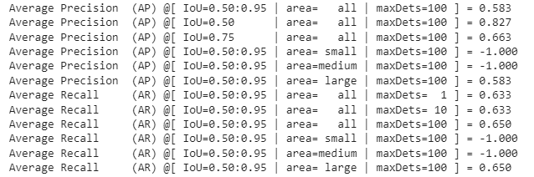
Model Performance Metrics

Slide 6
Demonstration: Object Detection

Slide 7
Demonstration: Cleaning

Slide 8
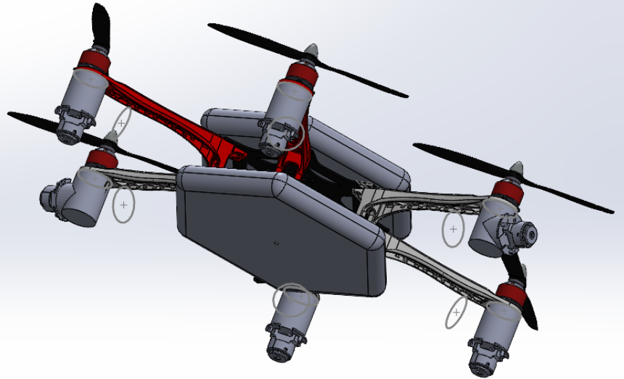
Future Iterations
Combine disinfection systems with more versatile mobility solutions such as aerial drones that can cover larger areas and perform a more thorough sanitation by accessing more spots (eg: heights, multistoried buildings)

